Slide 1

Constrained Deep Learning for System Identification and Differentiable Predictive Control of Nonlinear Systems
IDETC/CIE, 18th of August 2021
Jan Drgona
Collaborators: Elliott Skomski, Soumya Vasisht,
Aaron Tuor, Draguna Vrabie

Slide 2
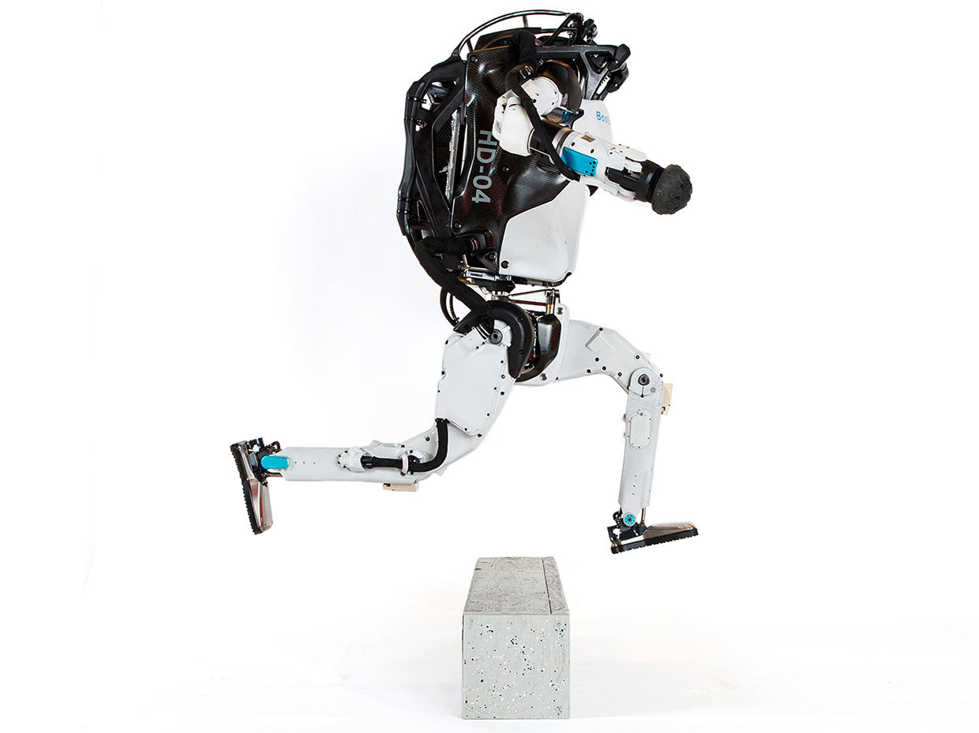


Model Predictive Control
Successes
Challenges
95% of the process control applications are PID loops using trial and error rule-based optimization. The rest is model predictive control (MPC).
Modeling
Unknown or partially known dynamics
Physics-based modeling is expensive
Purely data-driven models lack generalization
Real-time optimization
Scalability
Computational limitations of control hardware
Parallelization, distributed optimization
Assumption:
Reliable and accurate system dynamics model
Drgona J., J. Arroyo, I.C. Figueroa, D. Blum, K. Arendt, D. Kim, and E.P. Olle, J. Oravec, M. Wetter, D. L. Vrabie, L. Helsen. 2020. "All You Need to Know About Model Predictive Control for Buildings." Annual Reviews in Control, September 29, 2020
Notes:
Domain awareness, trusted autonomy
PID controller-
A PID controller continuously calculates an error value
the difference between a desired setpoint (SP) a process variable (PV) and
Correction based on proportion of error, integration of accumulated error, and derivative of the error
MPC first developed in the chemical industry to address some of the shortcomings of a PID controller.
Designed to handle MIMO systems
Can handle constraints
Preview capability
MPC uses a model to predict future outcomes of a process.
Online optimization problem at each process interval. Performs first action in the rollout.
requiring large memory and fast processor to operate in real time.
Training and calibration of models- lots of expert time
Optimization: translation to a solver language- lots of expert time
Computational limitations of control hardware depending on the system

Slide 3
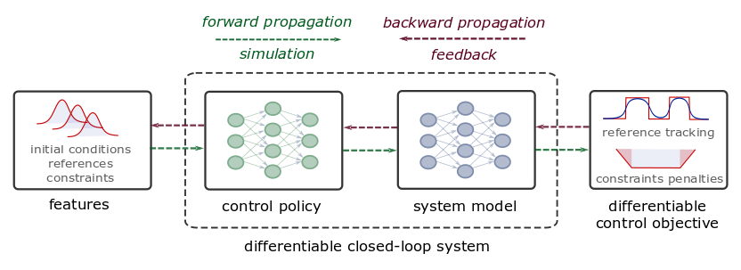
Differentiable Predictive Control
Predictive, safe, improving, trustworthy, efficient
Predictive: learning system dynamics
Robust and Adaptive: learning constrained control policies
Guarantees: stability theory
Scalable: learning from small datasets
Edge-computing: embedded applications
Jan Drgona, et al., Differentiable Predictive Control: An MPC Alternative for Unknown Nonlinear Systems using Constrained Deep Learning https://arxiv.org/abs/2011.03699
Jan Drgona, Aaron Tuor, Draguna Vrabie, Constrained Physics-Informed Deep Learning for Stable System Identification and Control of Unknown Linear Systems https://arxiv.org/abs/2004.11184
Notes:
Generic method for constrained model-based control
Can be trained end-to-end from time series dataset
Nonlinear constrained optimal control
Explicit neural network-based control policy
Scalability beyond the limitations of explicit MPC

Slide 4
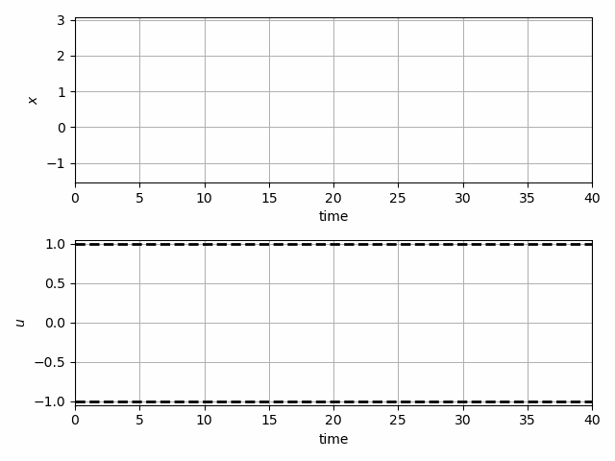
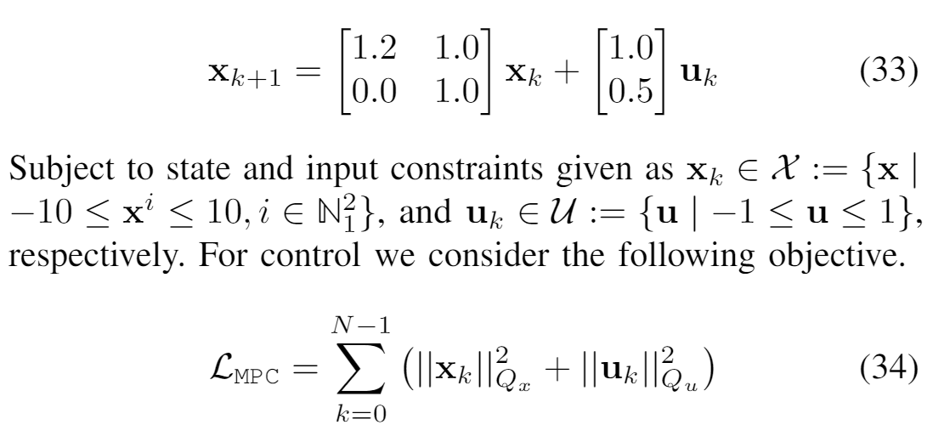
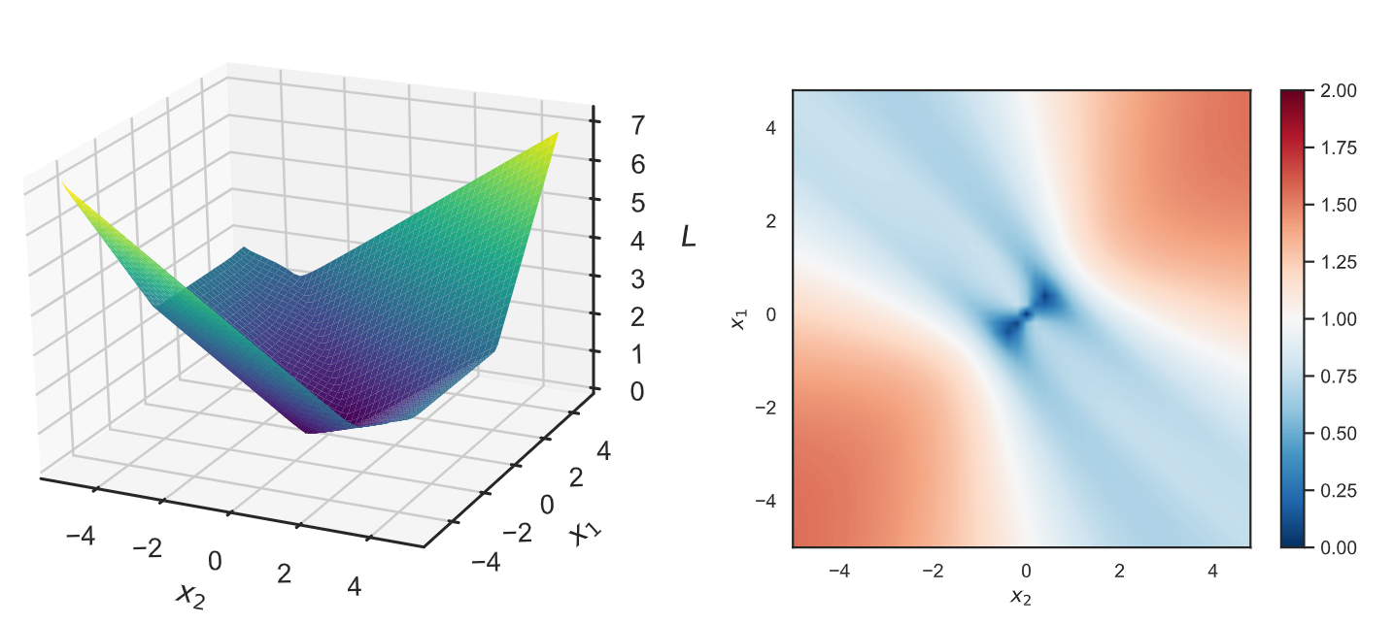
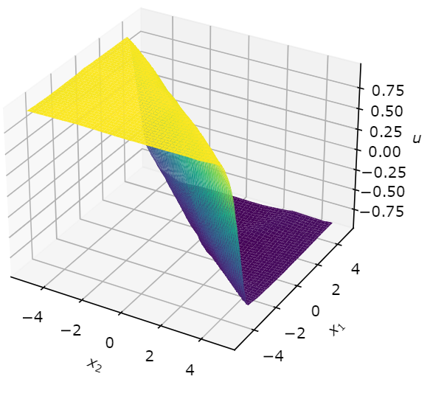
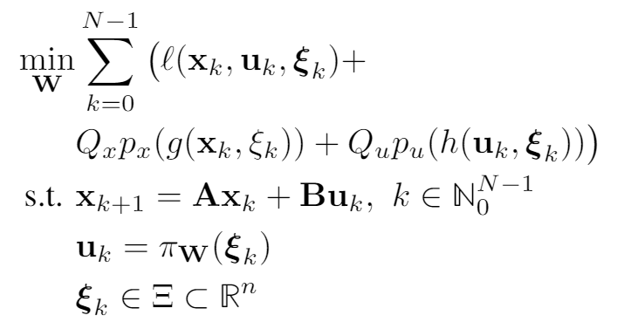
Learning to Stabilize Unstable System with DPC
Problem setup:
DPC formulation:
Drgona J., Tuor A., Vrabie D., Learning Stable Adaptive Explicit Differentiable Predictive Control for Unknown Linear Systems, under review, 2021

Slide 5
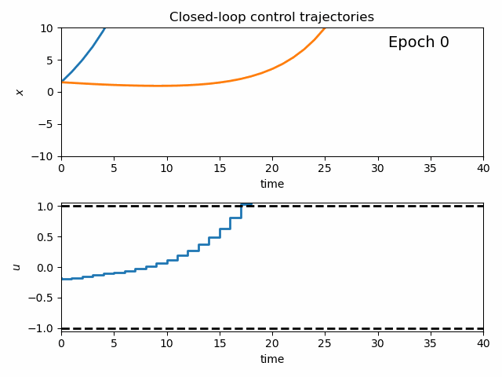
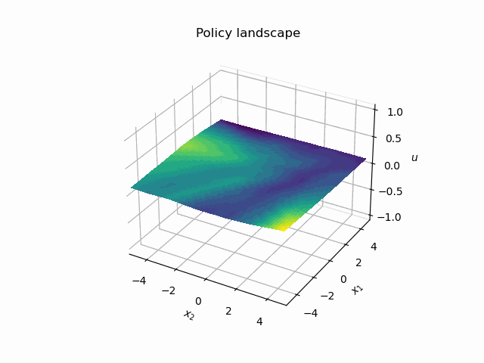
Dynamics of DPC Control Policy Learning
1341 learning parameters, 48.2 seconds offline training time on a CPU with 200 epochs.
Notes:
analyzing evolution of the controller during learning
Trajectories
Policy landscape
State space regions

Slide 6
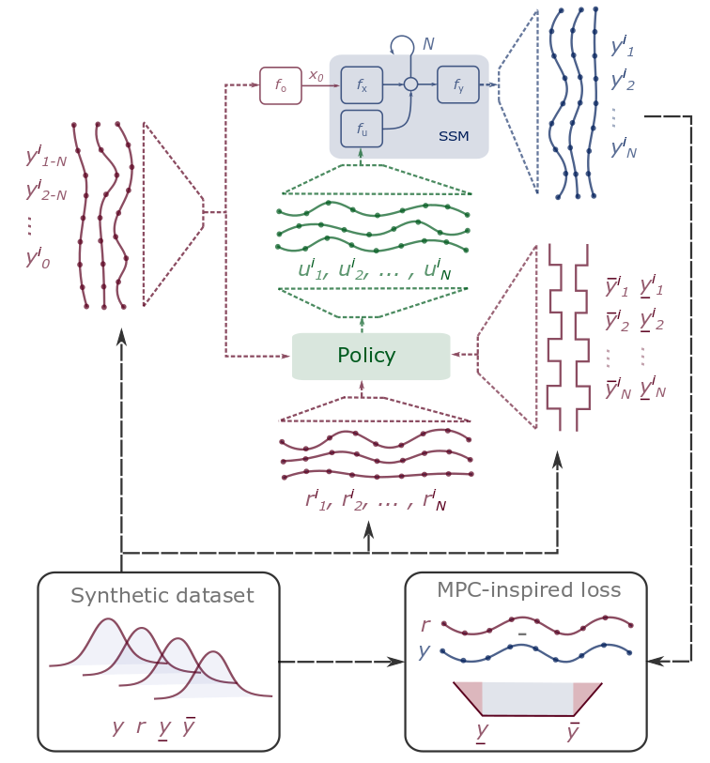
Conclusion
Differentiable Predictive Control
Differentiable system models
Explicit control policies
State and input constraints
Embedded implementation
Theoretical connection with MPC
Open-source Code
Neuromancer software package
https://github.com/pnnl/neuromancer
Structured linear maps in Pytorch
https://pnnl.github.io/slim/
Jan Drgona, et al., Differentiable Predictive Control: An MPC Alternative for Unknown Nonlinear Systems using Constrained Deep Learning https://arxiv.org/abs/2011.03699
Jan Drgona, Aaron Tuor, Draguna Vrabie, Constrained Physics-Informed Deep Learning for Stable System Identification and Control of Unknown Linear Systems https://arxiv.org/abs/2004.11184

Slide 7

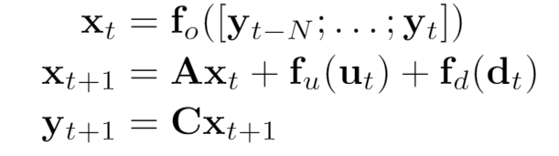
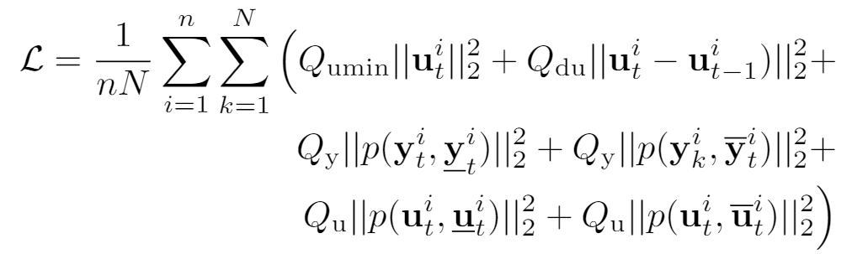
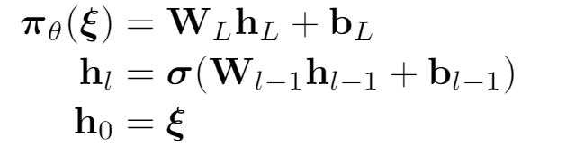
Economic DPC for Building Control
Economic MPC loss function
model
policy
Jan Drgona, Aaron Tuor, Elliott Skomski, Soumya Vasisht, Draguna Vrabie, Deep Learning Explicit Differentiable Predictive Control Laws for Buildings, IFAC NMPC 2021

Slide 8
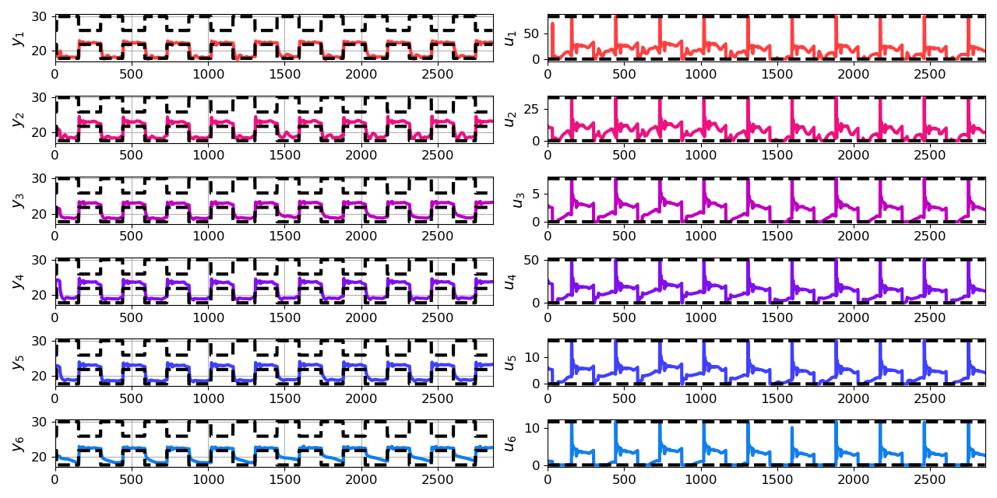
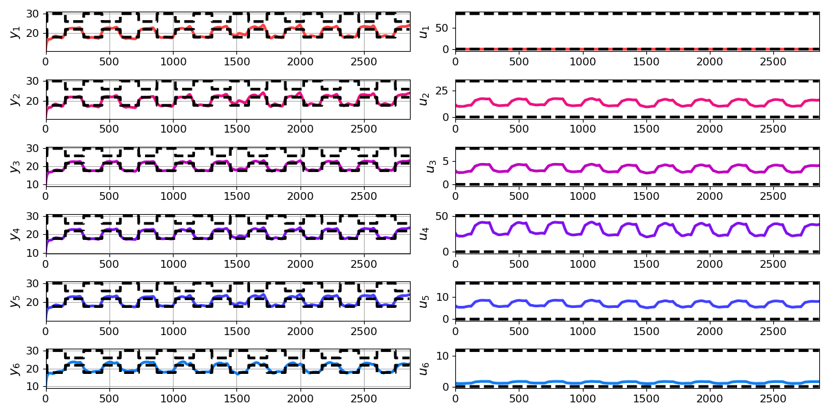
Closed-loop DPC of Multi-zone Building
Jan Drgona, Aaron Tuor, Elliott Skomski, Soumya Vasisht, Draguna Vrabie, Deep Learning Explicit Differentiable Predictive Control Laws for Buildings, IFAC NMPC 2021

